Slide 1
Safe Voice
Real time updates
Shlomi Zecharia – 315141242
Shani Avid - 323858324
Yasmin Cohen - 212733836

Slide 2
Division of roles between team members
Shlomi Zecharia - was involved in programming the code related to creating groups, sending recordings, was also involved in the design, responsible for uploading the codes to GitHub and dealing with everything related to it so that there are no conflicts at work.
Shani Evid - responsible for logistics and quality control of the project - was responsible for thinking about what needs to be created at each stage, how the displays should look and where everything leads, thinking down to the smallest details, was responsible for ensuring at each stage the quality that would be the most convenient and understandable for the user.
Yasmin Cohen - mainly dealt with the Firebase server and all the functionality needed for that in the code, retrieving income updates, sorting as needed, everything related to saving the data, and was also responsible for the adapters that allow displaying data with recycleView in a convenient and clear way.

Slide 3
The need for the SafeVoice application
Since the war started, we all want to be constantly updated on the news, and the safety of our relatives, family/friends, whether it's concern for soldiers serving in Gaza or in the north, or for elderly parents who are sometimes caught by alarms. There are many, many reasons to worry today, and on Saturdays the pressure rises another notch. Religious people who observe Shabbat, disconnect from their phones during Shabbat and remain stressed about the situation outside and their loved ones. In the case of mental control they will of course be called, but we are talking about cases of concern only, for example: parents who want to hear from the commander that the child soldier has left or entered Gaza. We wanted to create an application that could provide them with updates if necessary, without harming the sanctity of Shabbat.
The problem:
religious people are not allowed to use the phone on Shabbat and they worry terribly and are unable to keep up to date.
Purpose:
to create a platform where religious people can stay on Shabbat updated on the condition of their loved ones without desecrating the Shabbat
The idea for the solution:
to have the possibility to hear voice messages in real time from certain groups - and thus stay updated without touching the phone at all
Currently, we have not found any platform that allows religious people to stay connected to certain groups and hear live recordings without ever touching the phone.

Slide 4
Description of the planned system
The system is divided into 3 important parts.
Groups I am registered to –
I receive voice messages there from the group manager
Eruption of recordings in real time –
only in a certain situation that the group members enter, this option occurs
Groups that I manage –
I can send recordings there and they will be hacked into the phones of the group members and saved

Slide 5
Central requirements of the system
Functionality-
1. Option for the group manager and only him to record voice messages and send them to group members
2. Hearing the recorded message again after it arrived.
3. The administrator can listen to the recording before sending.
4. Option for the administrator to see who heard the message both in the event of an outbreak and afterwards.
5. The possibility that the message will explode in real time.
6. Joining groups and creating groups.
7. See recording history.
8. Automatic reading approvals.
9. The possibility that the incoming recording will be played automatically without contact.
Not functionality-
Even if several messages are recorded at the same time, not everything will be heard and information will not disappear.

Slide 6
Key features for implementation
Groups
Records
Creating and deleting groups
Option to invite people to the group
Allow to see group history.
Send messages through the group.
Receive messages in the group.
Leave a group
record tapes
Listen again if you want and send
The recordings could be played automatically in a certain situation.
Recording history.
Hearing confirmation.

Slide 7
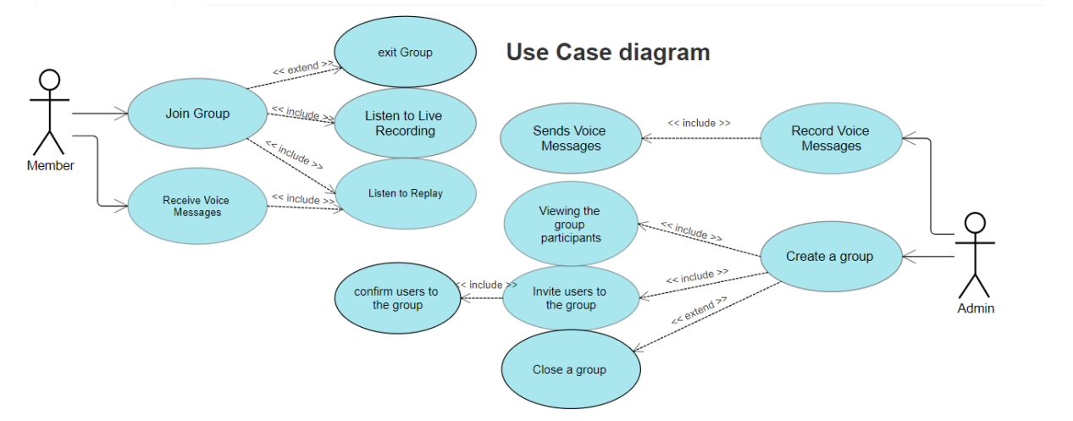
Use Case diagram

Slide 8
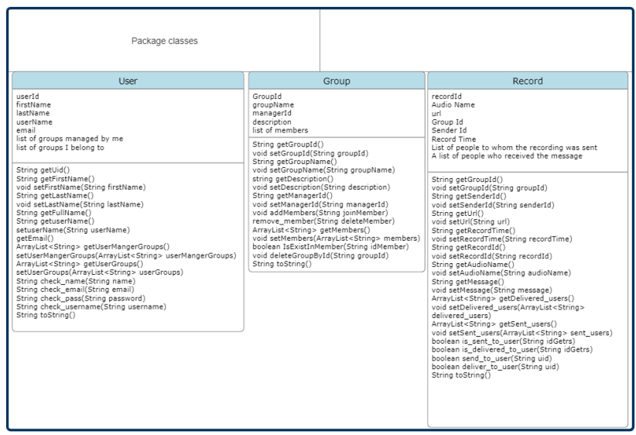
Class diagram

Slide 9
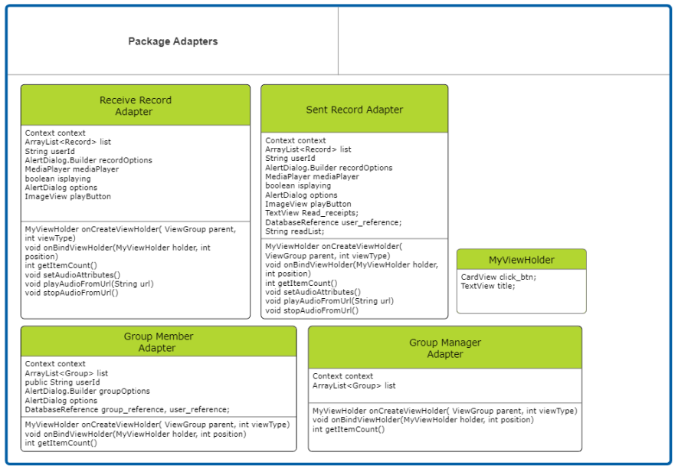
Class diagram

Slide 10
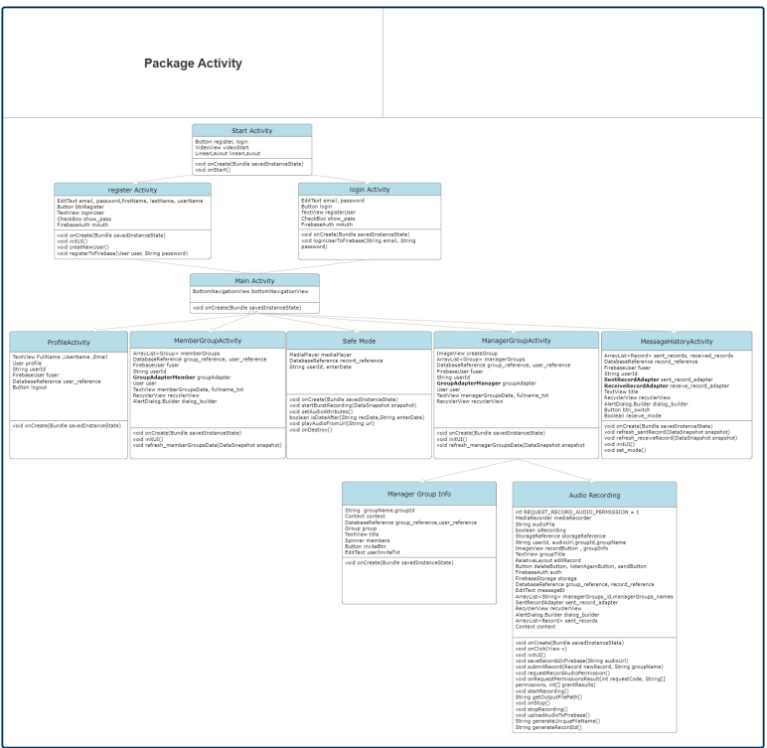

Slide 11
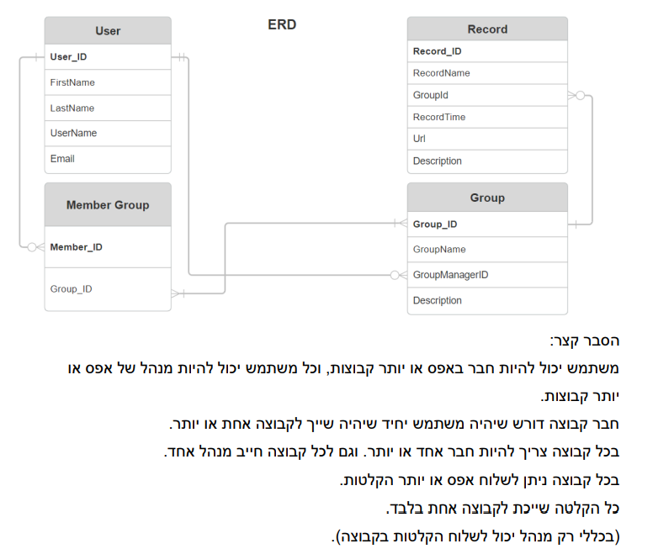

Slide 12
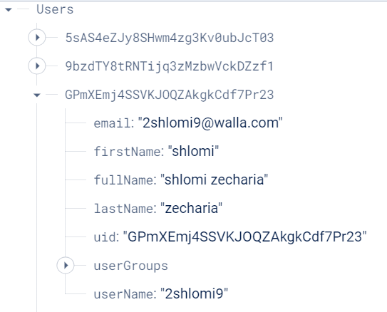
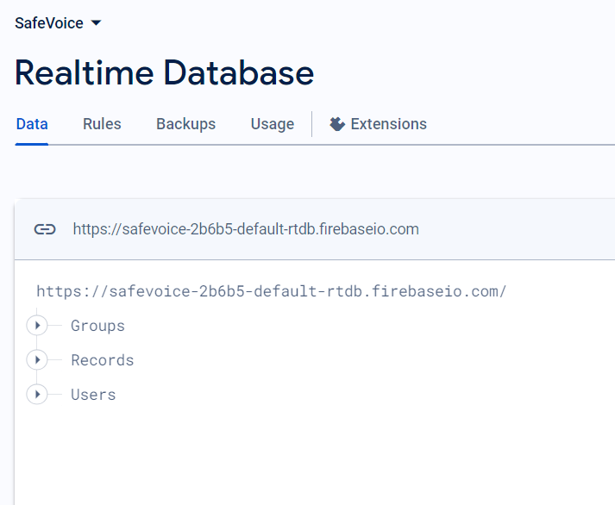
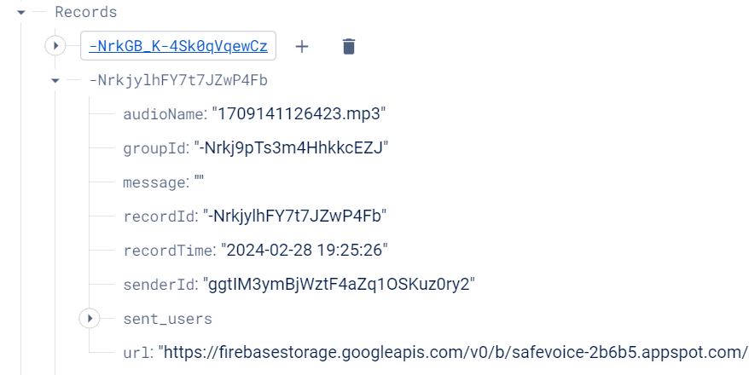
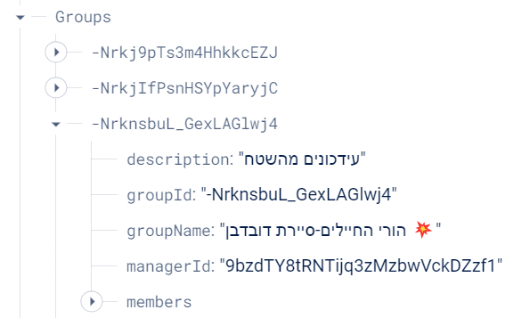
Firebase
מבנה המערכת בפועל ומיקום חלקיה

Slide 13
System description
We have also prepared a video that explains the use and screenshots that show an example of using the application...
(The video is shown in Hebrew)

Slide 14
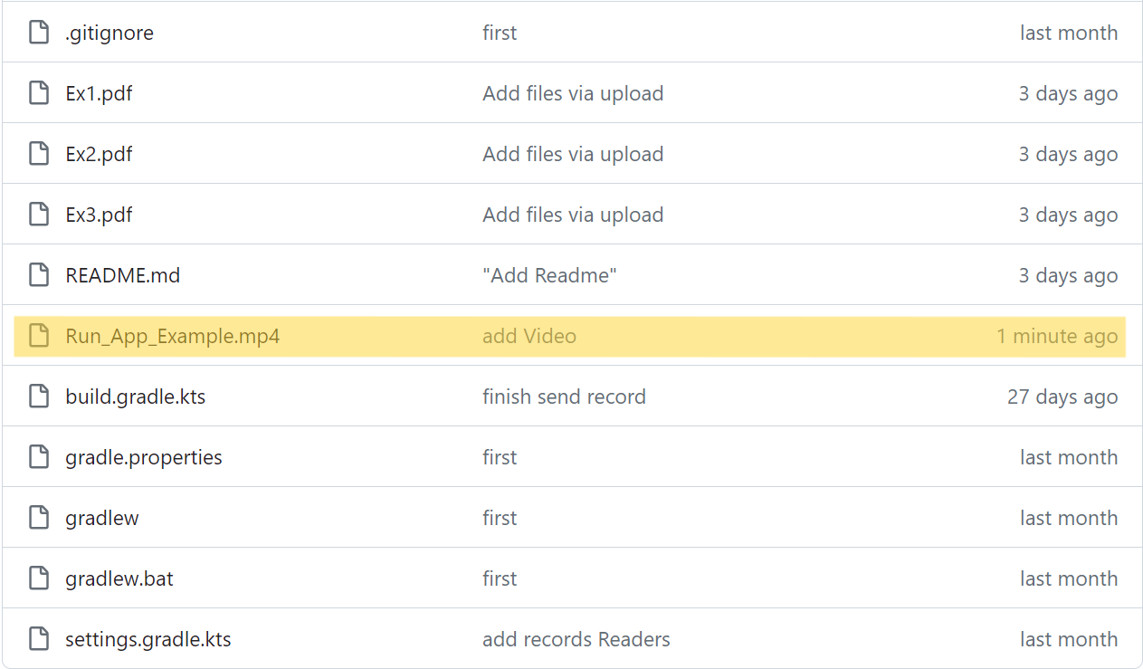
Go To :
https://github.com/2shlomi9/SaveVoiceApp

Slide 15
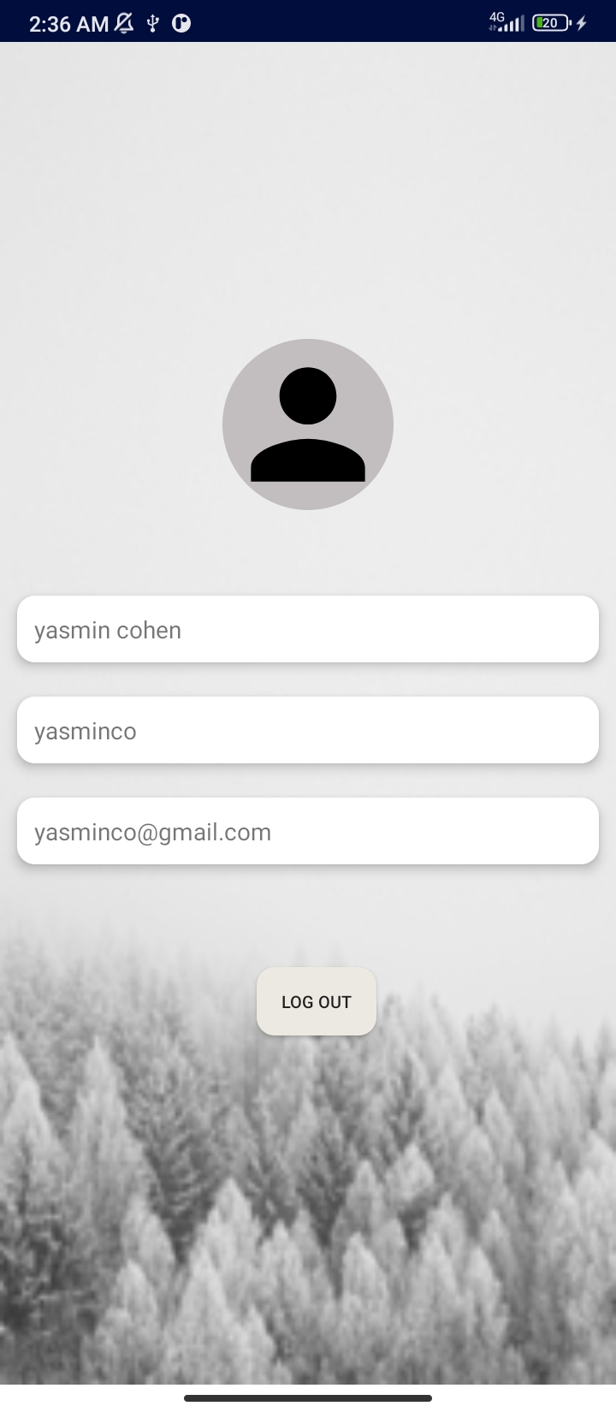
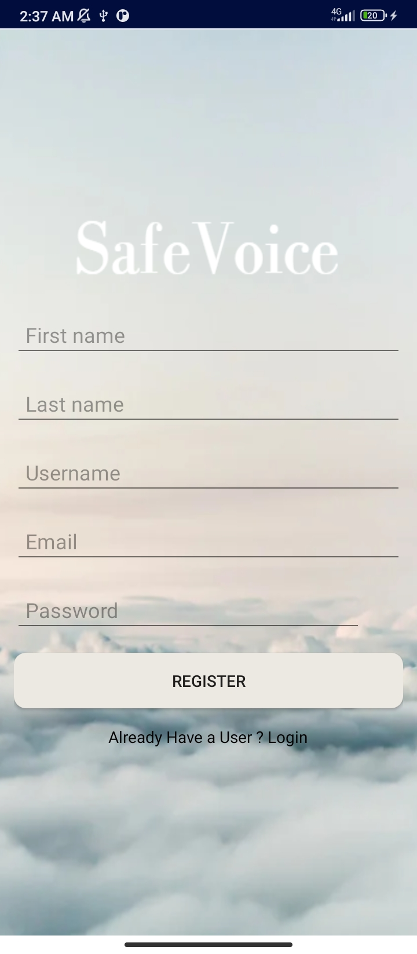
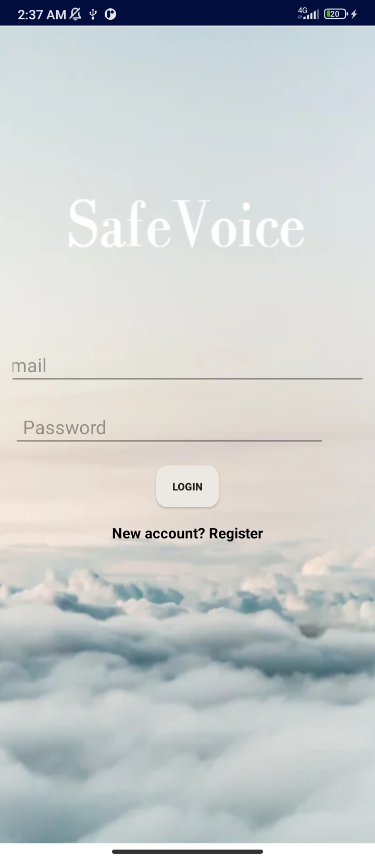

Three login screens and at the end the profile view

Slide 16
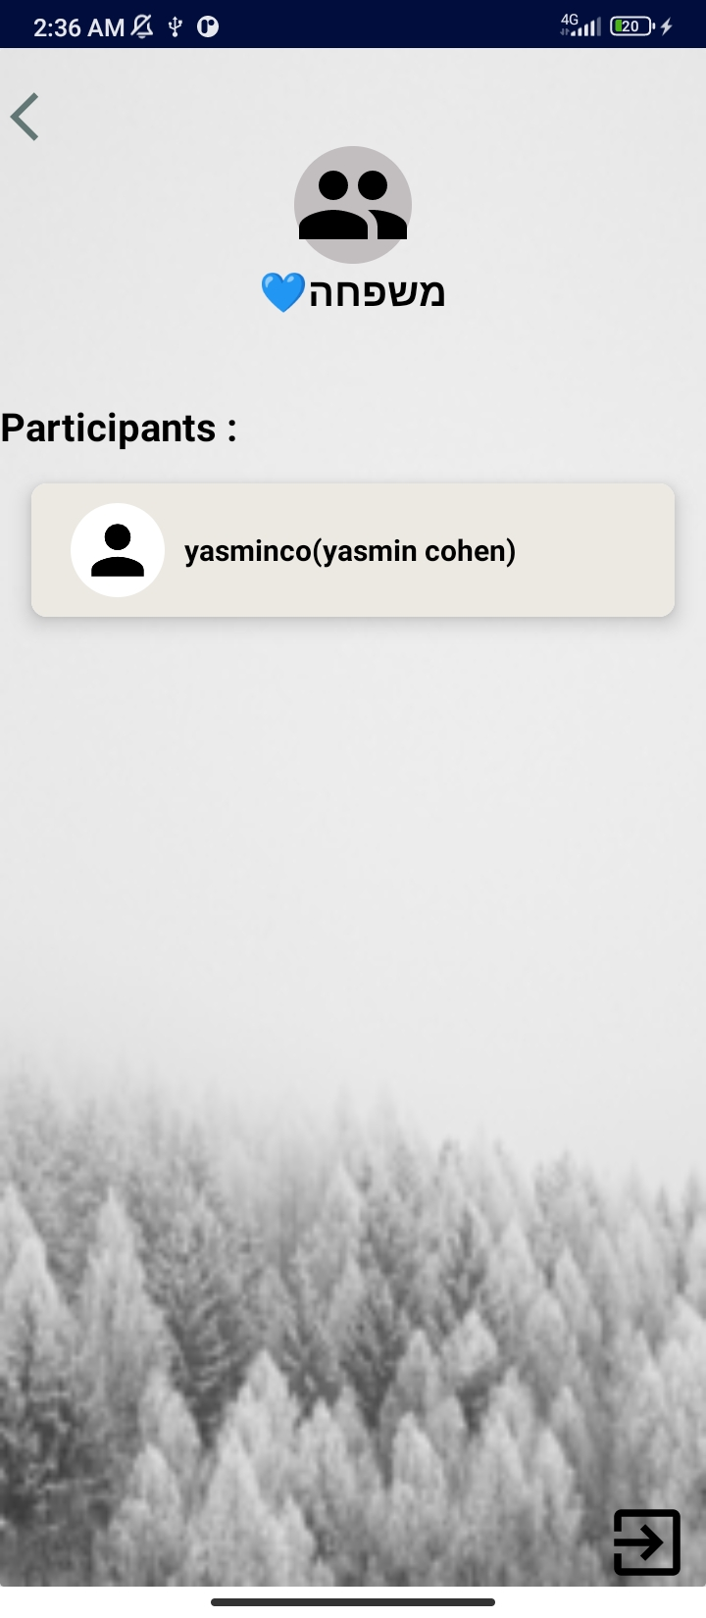
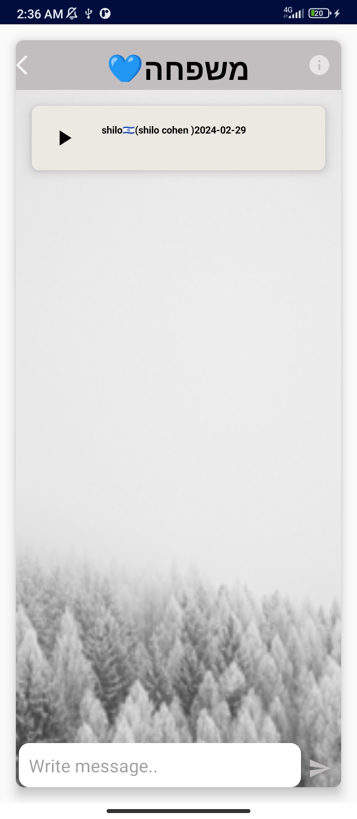
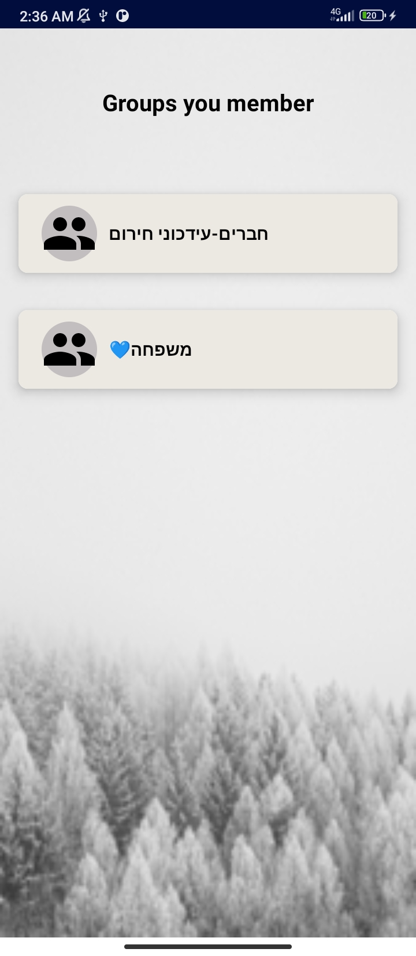
These are groups to which the user is registered to receive voice messages from the group manager

Slide 17
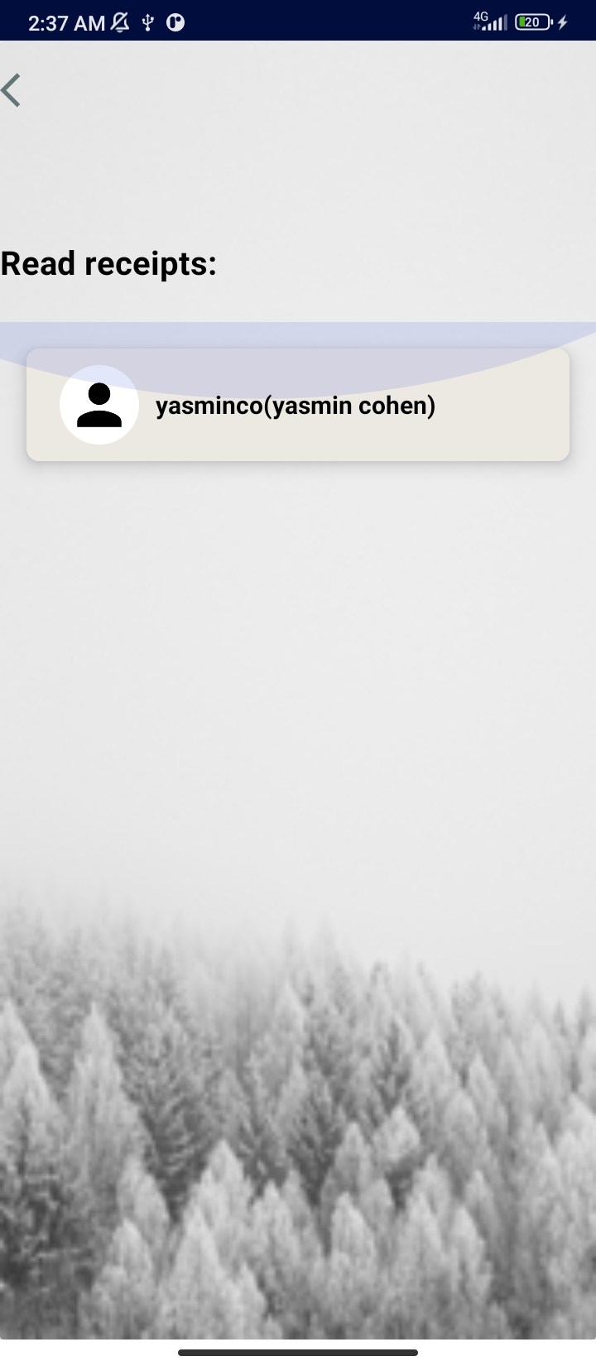
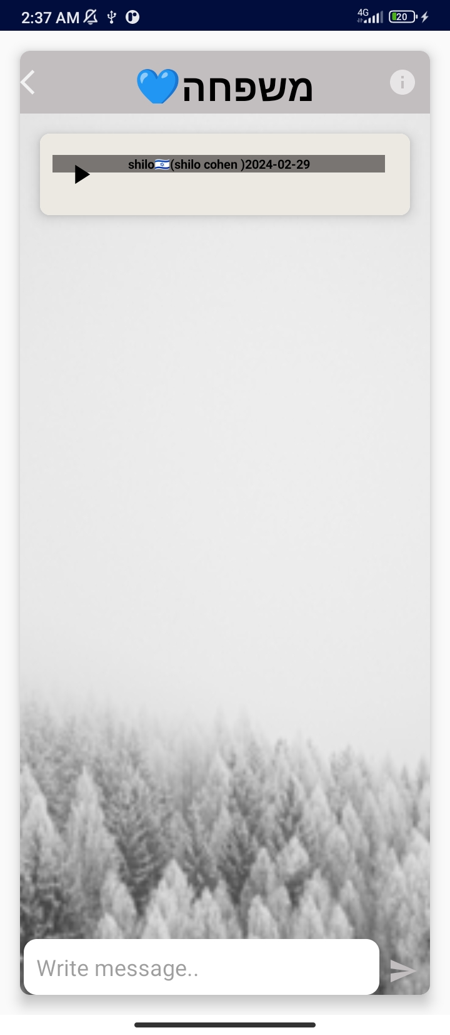
After listening to the recording sent to the groups I belong to, the color changes to gray and both the administrator and participants can see read receipts

Slide 18
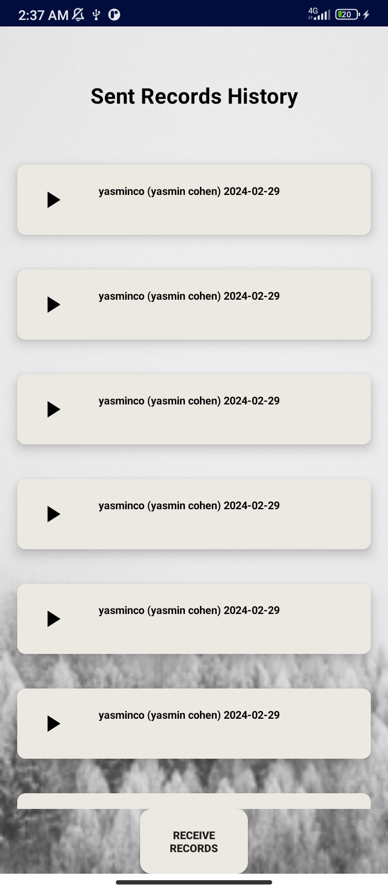
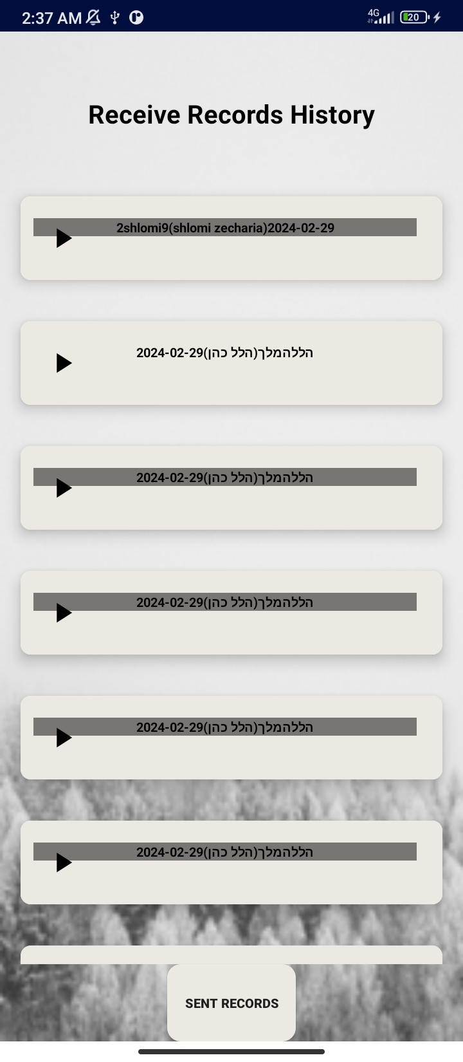
Message history - you can see in the history all the messages you sent in the groups you manage arranged by time, and also the recordings you received, what is marked you heard and what you didn't, you didn't.

Slide 19
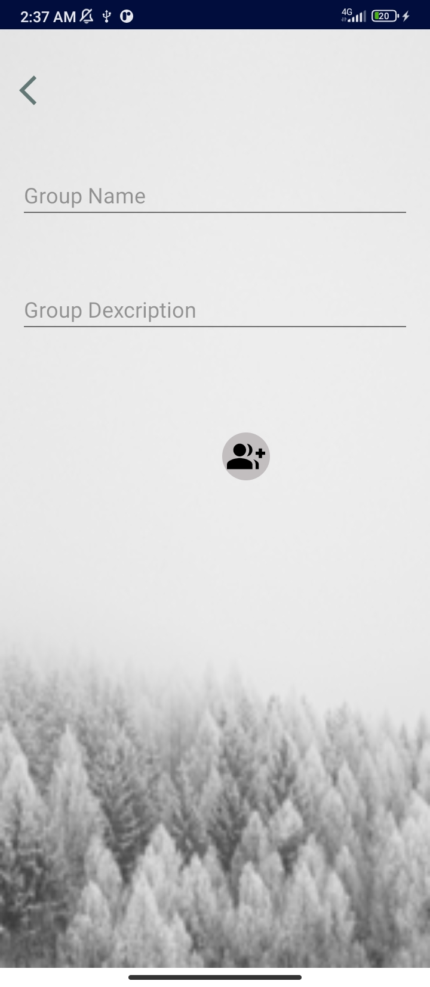
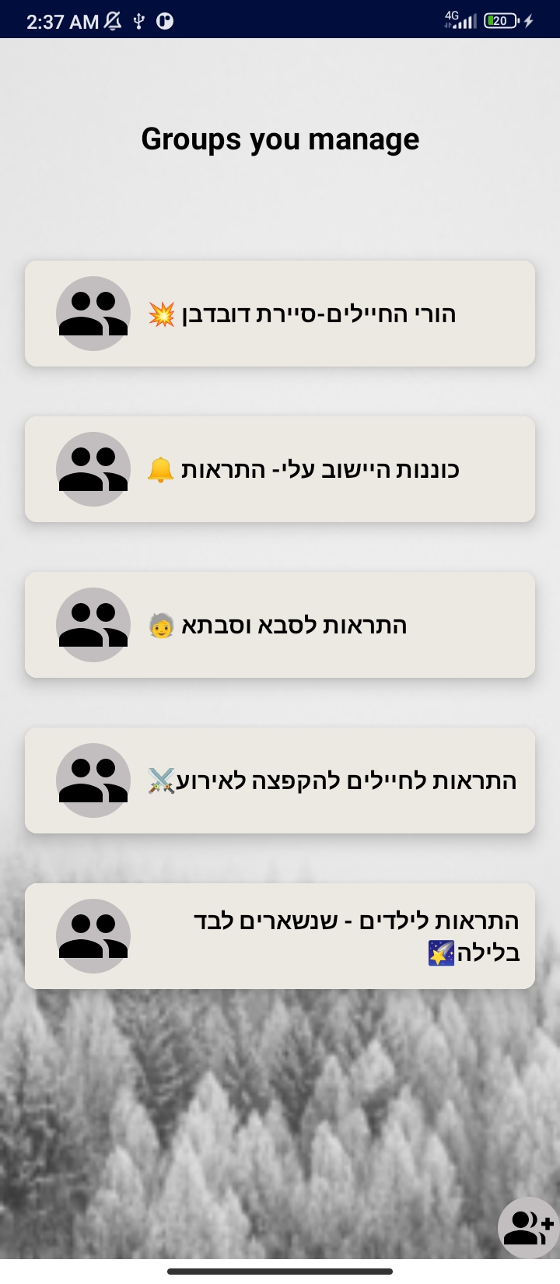
These are the groups I manage, there is a list of them here, and an option below to add another group.

Slide 20
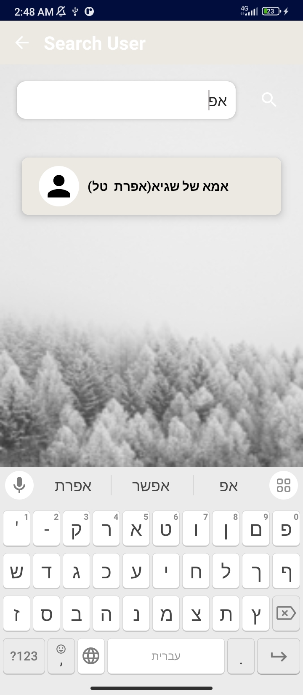
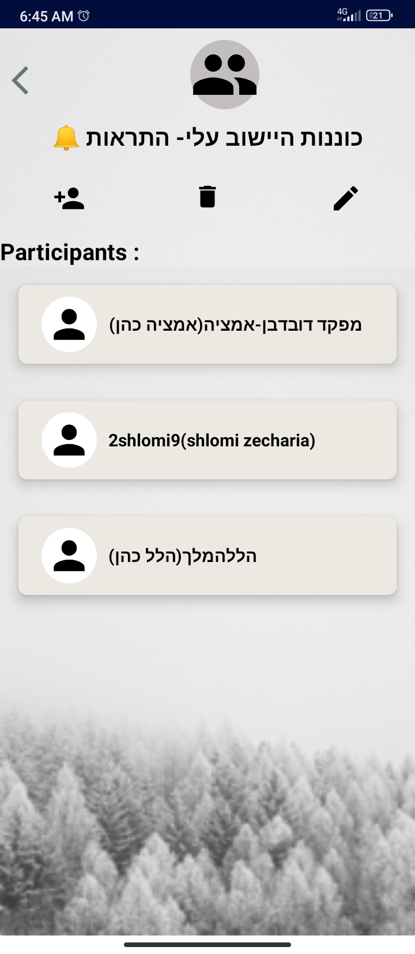
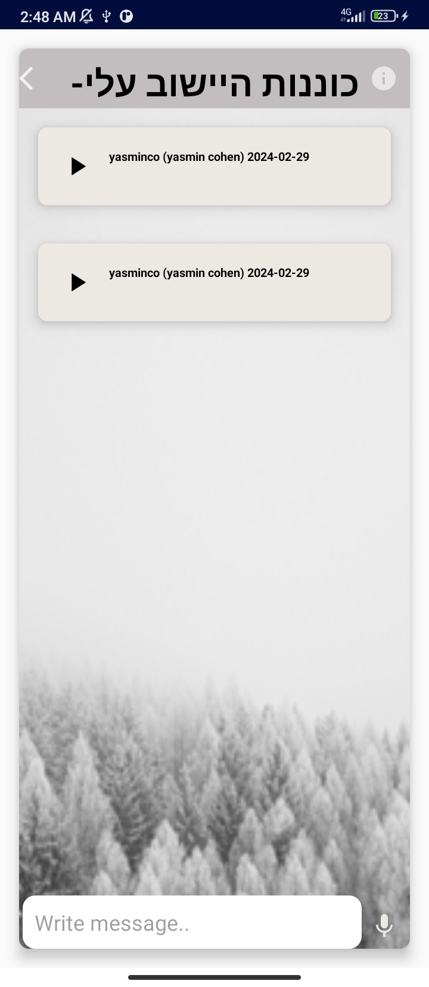
These are the groups I manage, there is a list of them here, and the option here is to enter one of the groups I manage, I have the option to record and send below, hear again what I sent and enter the group settings. There I have an option to invite participants by searching for them. Delete a group, and edit its name.
Add another group below.

Slide 21
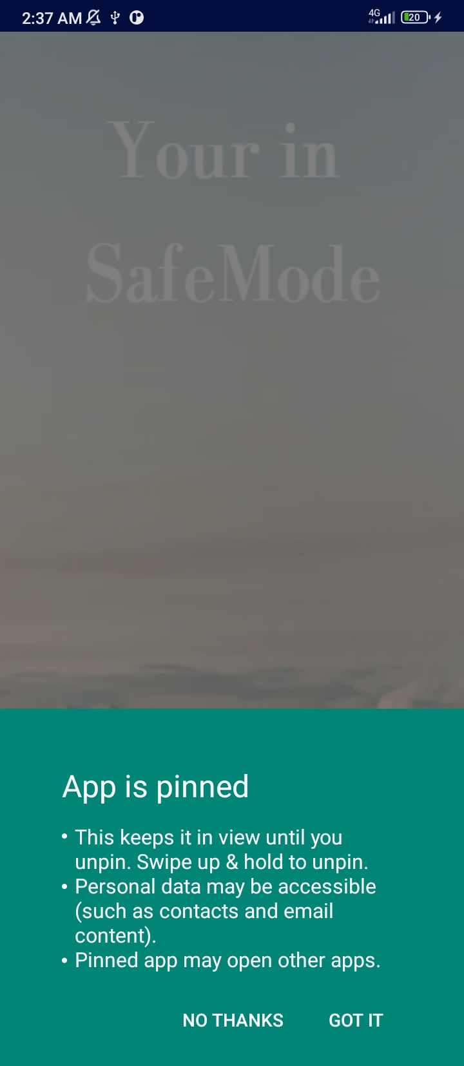
This is the state the user is in when they want to be available for burst messages. It automatically puts it into a mode where all other apps are deactivated and only this one remains open, very suitable for sitting.

Slide 22
Gaps between what we planned and what came out
The bursting message - we planned for the message to burst even when the application is not open, which means that it will run all the time in the background, but in the end we made it work only when it is open so that the user can decide when he wants to be listening and that it will not suddenly work for him in a place and time he does not want.
Silent mode - we planned for the playback of the recording to overcome silent mode and cancel it - and we didn't have time to learn how to do this functionality.
Sending a membership request - we planned that the user sends a membership request to the group.
At the end, for convenience, we made an administrator invite the users.
Recording a message - we planned that every group member could record and send an explosive message - in the end we made it so that only the manager could because it lost the purpose and the power that each group has that only the manager sends important things, and not everyone.
Sending a written message - we planned for the group members to be able to send text messages as reading confirmations and in the end we didn't do that, they can send automatic reading confirmations by actually hearing the recording.

Slide 23
Thank you for listening!
The link to github : https://github.com/2shlomi9/SaveVoiceApp.git

